Slide 1



Customer Segmentation in R
Guided by Dr.Gopikrishnan S

Slide 2
ROLES AND RESPONSIBILITIES
Name and Reg No | Role | Responsibility
MANEESH MADALA 19BCE7192 | Team Lead | Organize meeting Scope document Case study
PATRI LALITHYA MANASA 19BCD7013 | Documentation | MoM, Final ppt and Project Report
AKELLA SIVA SAI ATCHYUT 19BCE7513 | Data Scientist | Preparation of dataset Data pre-processing Data cleaning
JATHIN KOLLA 19BCD7192 | Data Analyst | Need to analyse the data and predict the solution

Slide 3
INTRODUCTION
Customer Segmentation is the process of division of customer base into several groups of individuals that share a similarity in different ways that are relevant to marketing such as gender, age, interests, and miscellaneous spending habits.
The technique of customer segmentation is dependent on several key differentiators that divide customers into groups to be targeted. Data related to demographics, geography, economic status as well as behavioral patterns play a crucial role in determining the company direction towards addressing the various segments.

Slide 4
AIM
Companies that deploy customer segmentation are under the notion that every customer has different requirements and require a specific marketing effort to address them appropriately. Companies aim to gain a deeper approach of the customer they are targeting. Therefore, their aim has to be specific and should be tailored to address the requirements of each and every individual customer. Furthermore, through the data collected, companies can gain a deeper understanding of customer preferences as well as the requirements for discovering valuable segments that would reap them maximum profit. This way, they can strategize their marketing techniques more efficiently and minimize the possibility of risk to their investment.

Slide 5
APPROACH
In the first step of this data science project, we will perform data exploration. We will import the essential packages required for this role and then read our data. Finally, we will go through the input data to gain necessary insights about it.
In this project, you will use the K-means algorithm for clustering an unlabelled dataset. The K-means clustering algorithm can effectively visualize the age and gender distributions in the dataset. Further, it will also analyse annual incomes and spending patterns.

Slide 6
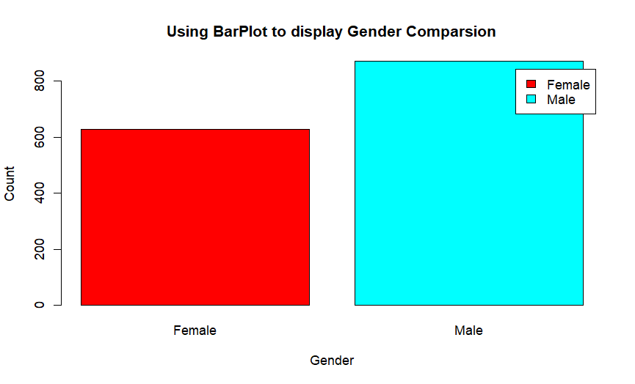
CUSTOMER GENDER VISUALIZATION
In this, we will create a bar plot and a pie chart to show the gender distribution across our customer_data dataset.
From the above barplot, we observe that the number of females is higher than the males. Now, let us visualize a pie chart to observe the ratio of male and female distribution.

Slide 7
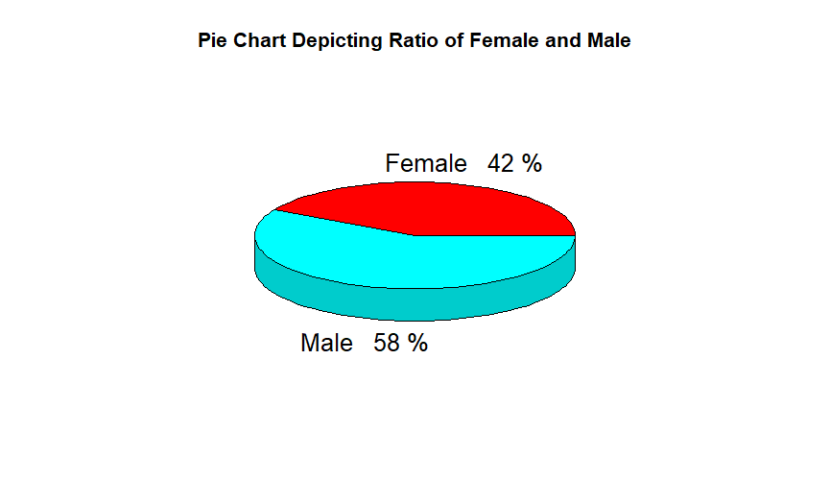
CUSTOMER GENDER VISUALIZATION
From the above graph, we conclude that the percentage of females is 58%, whereas the percentage of male in the customer dataset is 42%.

Slide 8
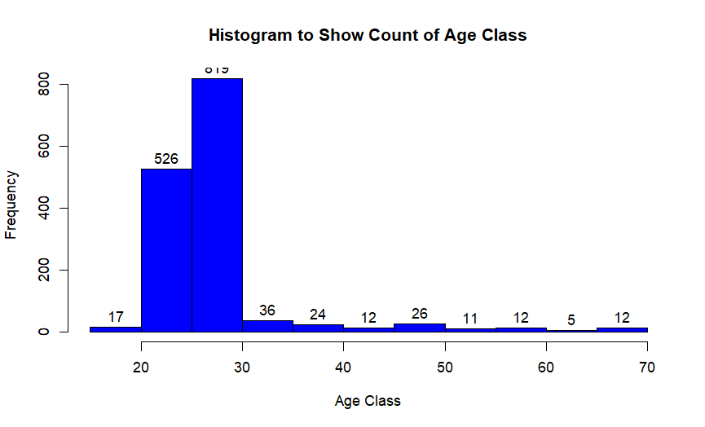
VISUALIZATION OF AGE DISTRIBUTION
Let us plot a histogram to view the distribution to plot the frequency of customer ages. We will first proceed by taking summary of the Age variable.

Slide 9
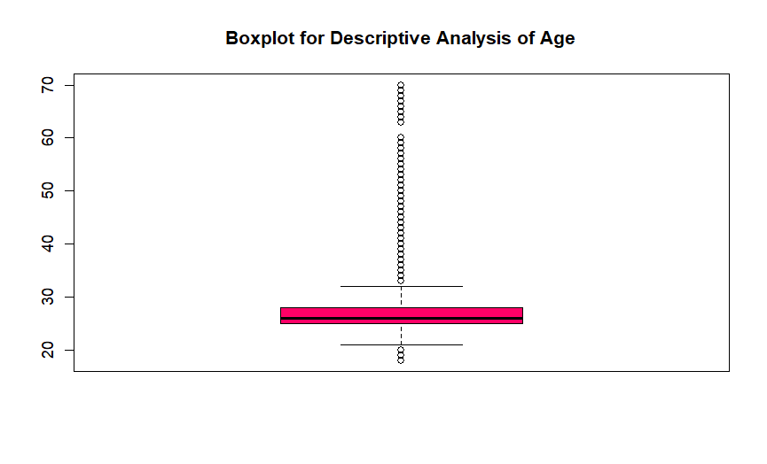
VISUALIZATION OF AGE DISTRIBUTION
From the above two visualizations, we conclude that the maximum customer ages are between 25 and 30. The minimum age of customers is 18, whereas , the maximum age is 70.

Slide 10
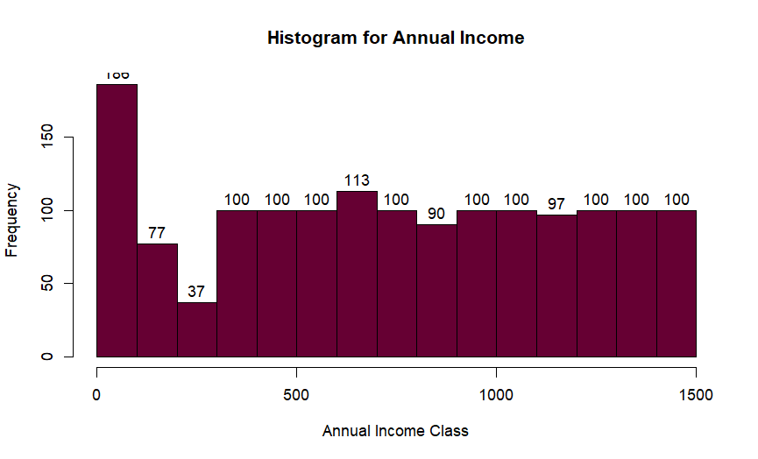
ANALYSIS OF THE ANNUAL INCOME OF THE CUSTOMERS
In this section of the R project, we will create visualizations to analyze the annual income of the customers. We will plot a histogram and then we will proceed to examine this data using a density plot.

Slide 11
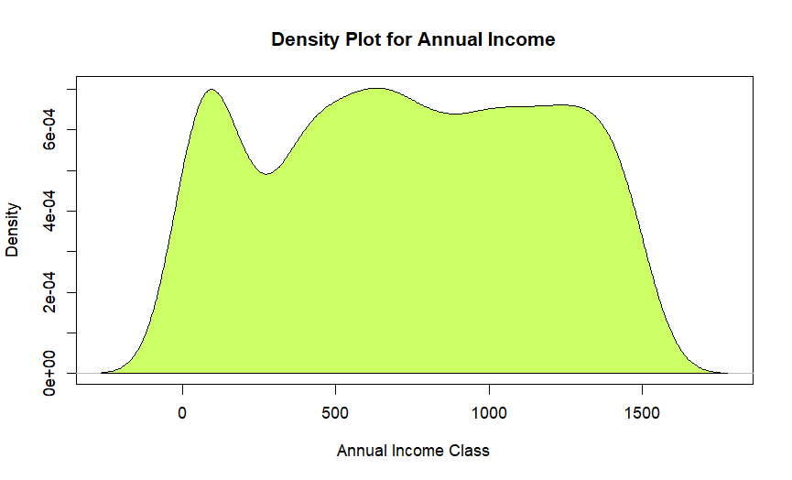
ANALYSIS OF THE ANNUAL INCOME OF THE CUSTOMERS
From the above descriptive analysis, we conclude that the minimum annual income of the customers is 15 and the maximum income is 137. People earning an average income of 70 have the highest frequency count in our histogram distribution. The average salary of all the customers is 60.56. In the Kernel Density Plot that we displayed above, we observe that the annual income has a normal distribution.

Slide 12
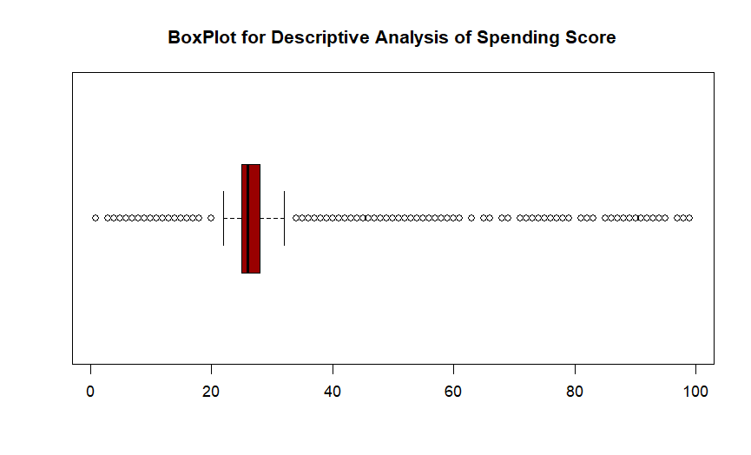
ANALYZING SPENING SCORE OF THE CUSTOMERS

Slide 13
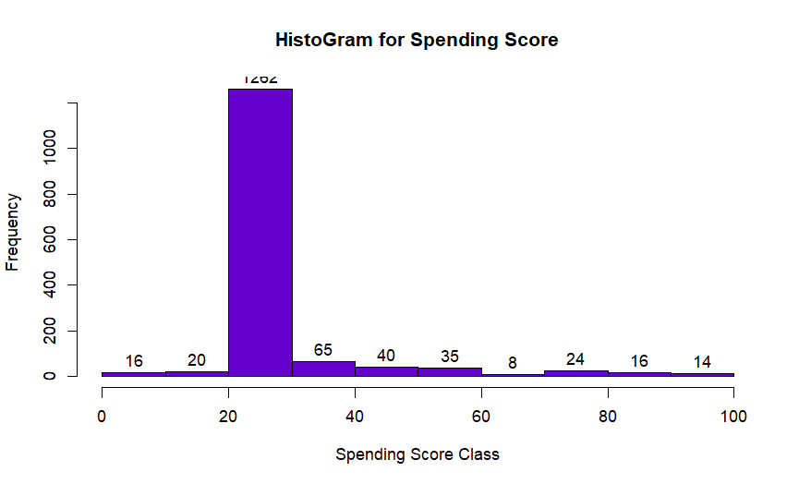
ANALYZING SPENING SCORE OF THE CUSTOMERS
The minimum spending score is 1, maximum is 99 and the average is 50.20. We can see Descriptive Analysis of Spending Score is that Min is 1, Max is 99 and avg. is 50.20. From the histogram, we conclude that customers between class 20 and 30 have the highest spending score among all the classes.

Slide 14
K-MEANS ALGORITHM
We specify the number of clusters that we need to create.
The algorithm selects k objects at random from the dataset. This object is the initial cluster or mean.
The closest centroid obtains the assignment of a new observation. We base this assignment on the Euclidean Distance between object and the centroid.
k clusters in the data points update the centroid through calculation of the new mean values present in all the data points of the cluster. The kth cluster’s centroid has a length of p that contains means of all variables for observations in the k-th cluster. We denote the number of variables with p.
Iterative minimization of the total within the sum of squares. Then through the iterative minimization of the total sum of the square, the assignment stop wavering when we achieve maximum iteration. The default value is 10 that the R software uses for the maximum iterations.

Slide 15
DETERMINING OPTIMAL CLUSTERS
While working with clusters, you need to specify the number of clusters to use. You would like to utilize the optimal number of clusters. To help you in determining the optimal clusters, there are three popular methods –
Elbow method
Silhouette method
Gap statistic

Slide 16
ELBOW METHOD
The main goal behind cluster partitioning methods like k-means is to define the clusters such that the intra-cluster variation stays minimum.
minimize(sum W(Ck)), k=1…k
Where Ck represents the kth cluster and W(Ck) denotes the intra-cluster variation. With the measurement of the total intra-cluster variation, one can evaluate the compactness of the clustering boundary. We can then proceed to define the optimal clusters as follows –
First, we calculate the clustering algorithm for several values of k. This can be done by creating a variation within k from 1 to 10 clusters. We then calculate the total intra-cluster sum of square (iss). Then, we proceed to plot iss based on the number of k clusters. This plot denotes the appropriate number of clusters required in our model. In the plot, the location of a bend or a knee is the indication of the optimum number of clusters.

Slide 17
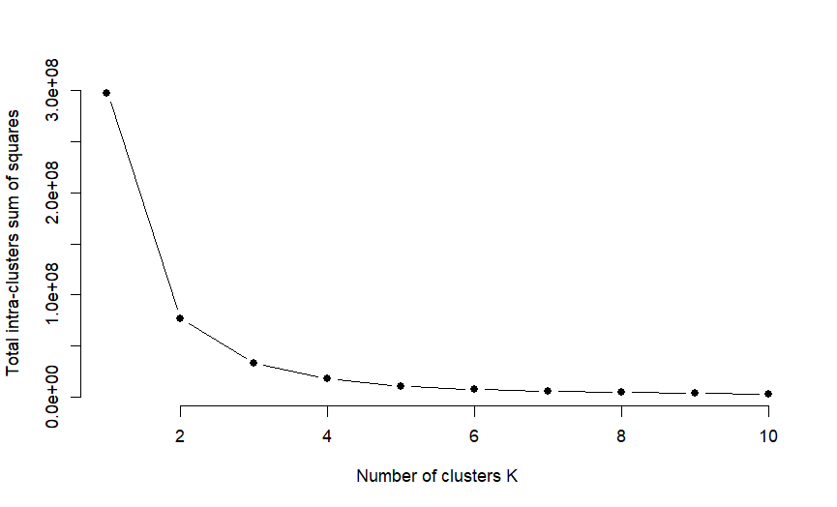
ELBOW METHOD
From the above graph, we conclude that 3 is the appropriate number of clusters since it seems to be appearing at the bend in the elbow plot.

Slide 18
AVERAGE SILHOUETTE METHOD
With the help of the average silhouette method, we can measure the quality of our clustering operation. With this, we can determine how well within the cluster is the data object. If we obtain a high average silhouette width, it means that we have good clustering. The average silhouette method calculates the mean of silhouette observations for different k values. With the optimal number of k clusters, one can maximize the average silhouette over significant values for k clusters.
Using the silhouette function in the cluster package, we can compute the average silhouette width using the kmean function. Here, the optimal cluster will possess highest average.

Slide 19
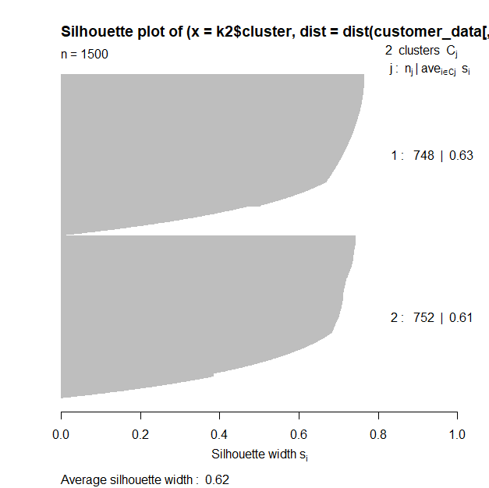
AVERAGE SILHOUETTE METHOD

Slide 20
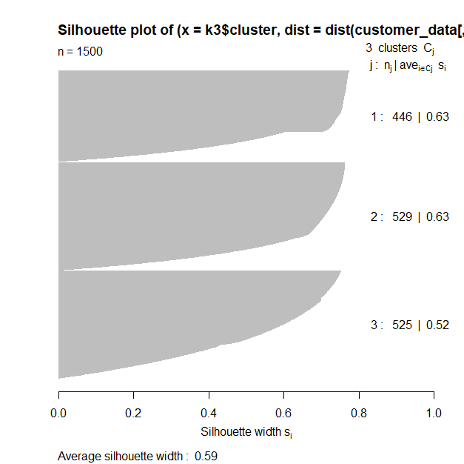
AVERAGE SILHOUETTE METHOD

Slide 21
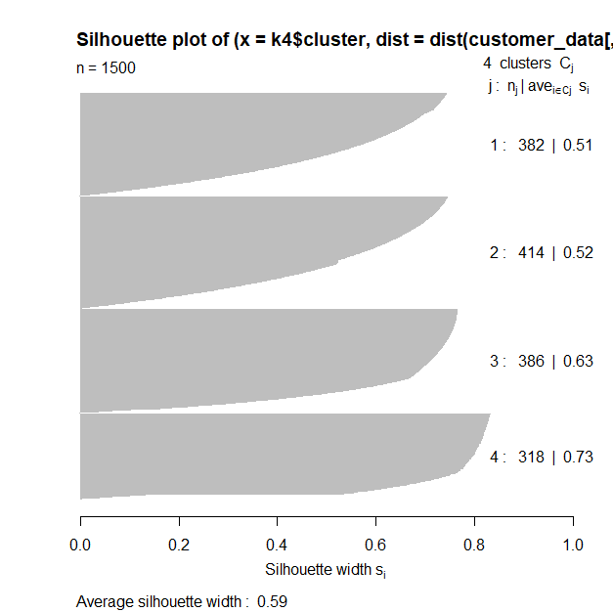
AVERAGE SILHOUETTE METHOD

Slide 22
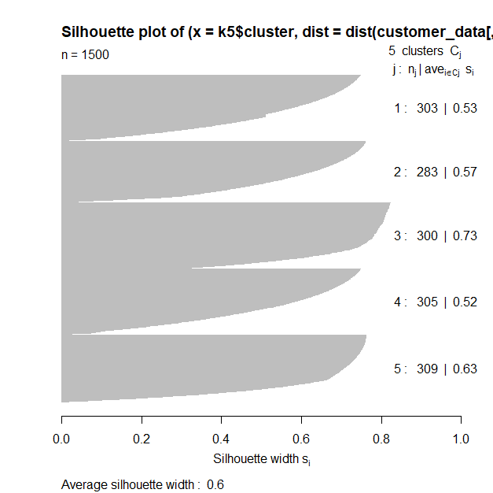
AVERAGE SILHOUETTE METHOD

Slide 23
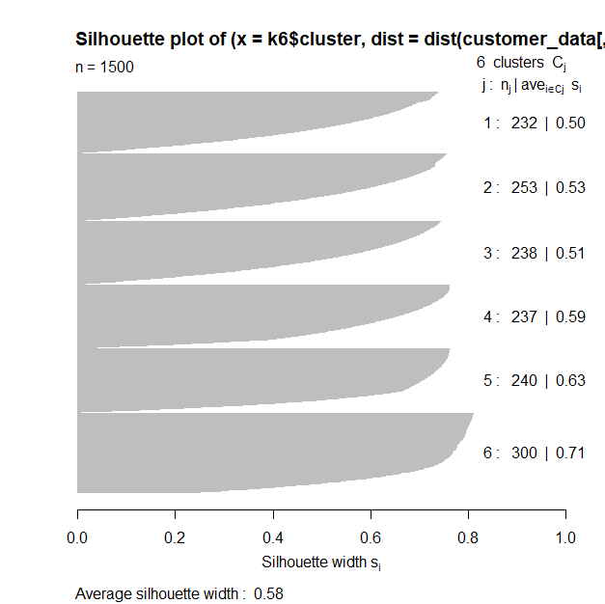
AVERAGE SILHOUETTE METHOD

Slide 24
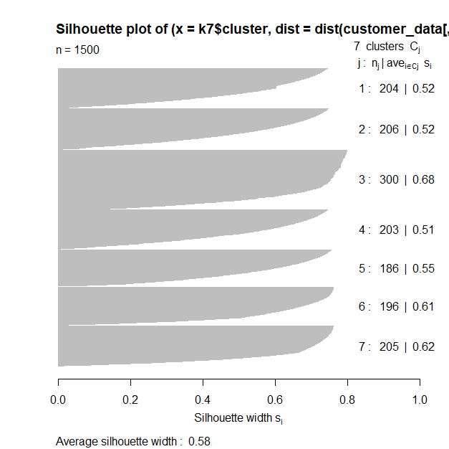
AVERAGE SILHOUETTE METHOD

Slide 25
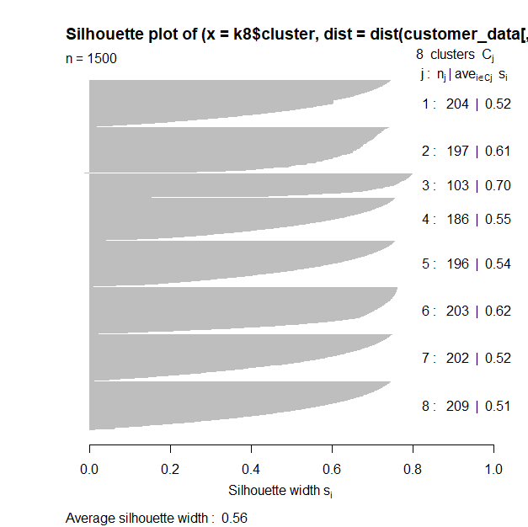
AVERAGE SILHOUETTE METHOD

Slide 26
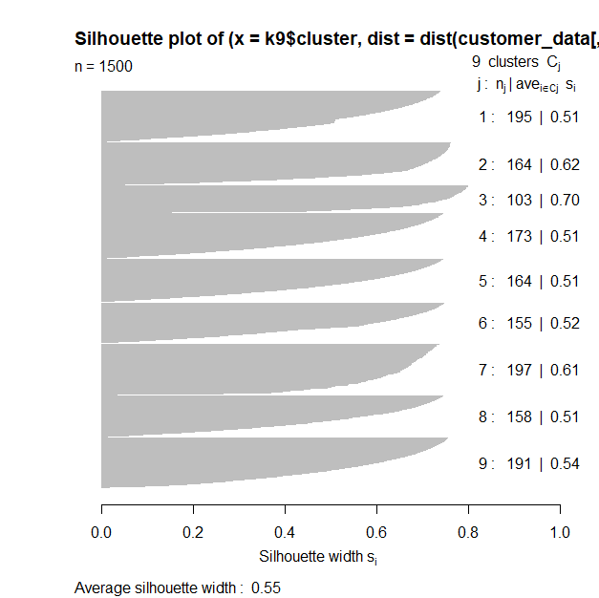
AVERAGE SILHOUETTE METHOD

Slide 27
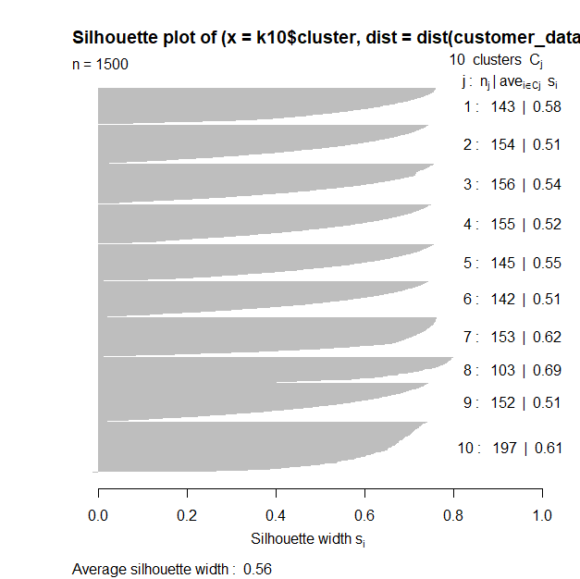
AVERAGE SILHOUETTE METHOD

Slide 28
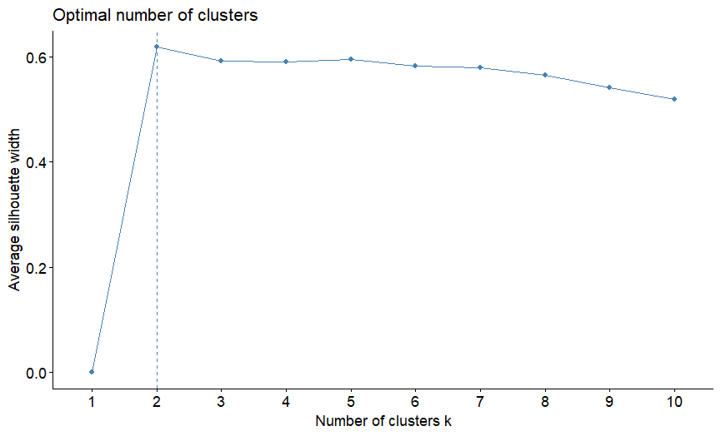
VISUALIZE THE OPTIMAL NUMBER OF CLUSTERS USING fviz_nbclust()
Now, we make use of the fviz_nbclust() function to determine and visualize the optimal number of clusters

Slide 29
GAP STATISTIC METHOD
In 2001, researchers at Stanford University – R. Tibshirani, G.Walther and T. Hastie published the Gap Statistic Method. We can use this method to any of the clustering method like K-means, hierarchical clustering etc. Using the gap statistic, one can compare the total intracluster variation for different values of k along with their expected values under the null reference distribution of data. With the help of Monte Carlo simulations, one can produce the sample dataset. For each variable in the dataset, we can calculate the range between min(xi) and max (xj) through which we can produce values uniformly from interval lower bound to upper bound.
For computing the gap statistics method we can utilize the clusGap function for providing gap statistic as well as standard error for a given output.

Slide 30
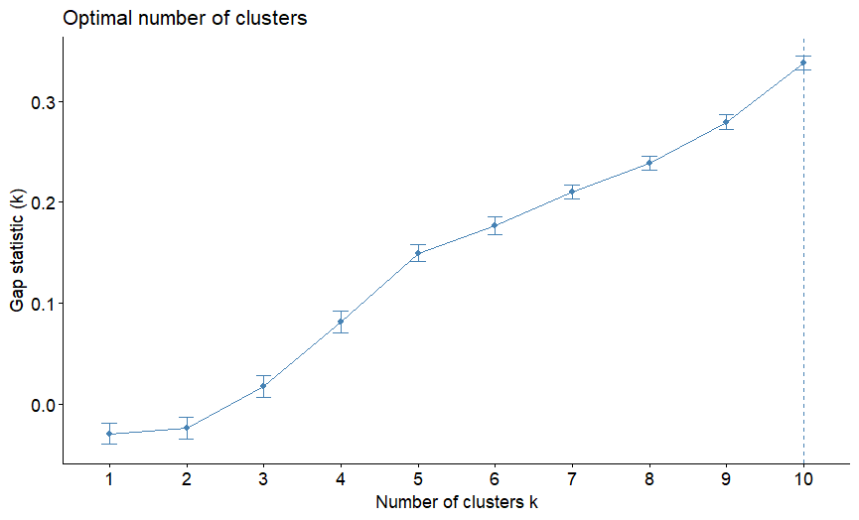
GAP STATISTIC METHOD

Slide 31
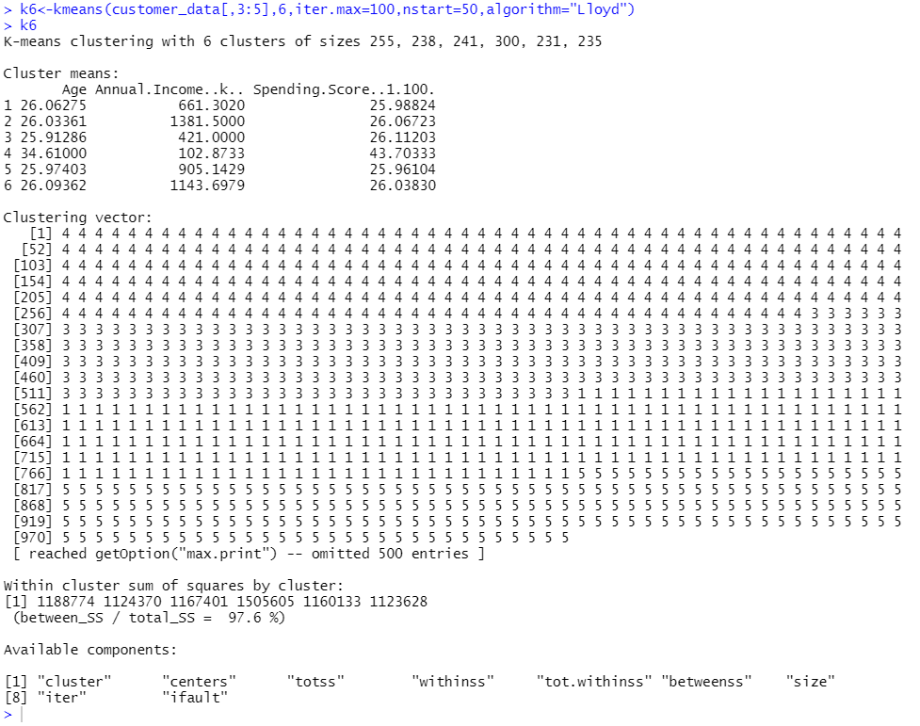
K-MEANS CLUSTERING
Now, let us take k = 6 as our optimal cluster

Slide 32
K-MEANS CLUSTERING
In the output of our kmeans operation, we observe a list with several key information. From this, we conclude the useful information being –
cluster – This is a vector of several integers that denote the cluster which has an allocation of each point.
totss – This represents the total sum of squares.
centers – Matrix comprising of several cluster centers
withinss – This is a vector representing the intra-cluster sum of squares having one component per cluster.
tot.withinss – This denotes the total intra-cluster sum of squares.
betweenss – This is the sum of between-cluster squares.
size – The total number of points that each cluster holds.

Slide 33
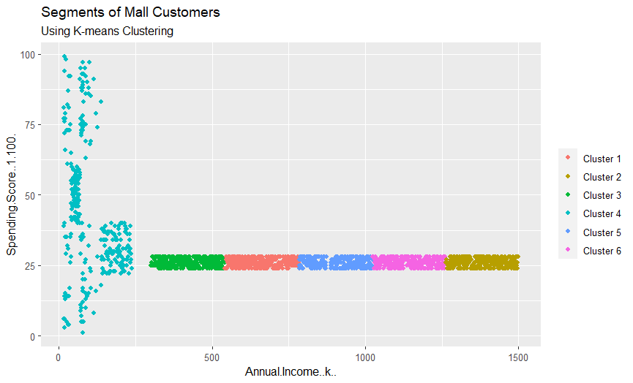
VISUALIZING THE CLUSTERING RESULTS USING THE FIRST TWO PRINCIPLE COMPONENTS

Slide 34
VISUALIZING THE CLUSTERING RESULTS USING THE FIRST TWO PRINCIPLE COMPONENTS
From the above visualization, we observe that there is a distribution of 6 clusters as follows –
Cluster 6 and 4 – These clusters represent the customer_data with the medium income salary as well as the medium annual spend of salary.
Cluster 1 – This cluster represents the customer_data having a high annual income as well as a high annual spend.
Cluster 3 – This cluster denotes the customer_data with low annual income as well as low yearly spend of income.
Cluster 2 – This cluster denotes a high annual income and low yearly spend.
Cluster 5 – This cluster represents a low annual income but its high yearly expenditure.

Slide 35
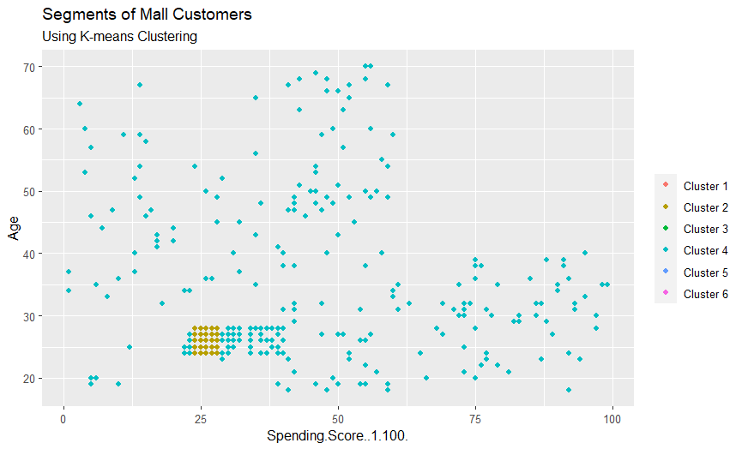
VISUALIZING THE CLUSTERING RESULTS USING THE FIRST TWO PRINCIPLE COMPONENTS

Slide 36
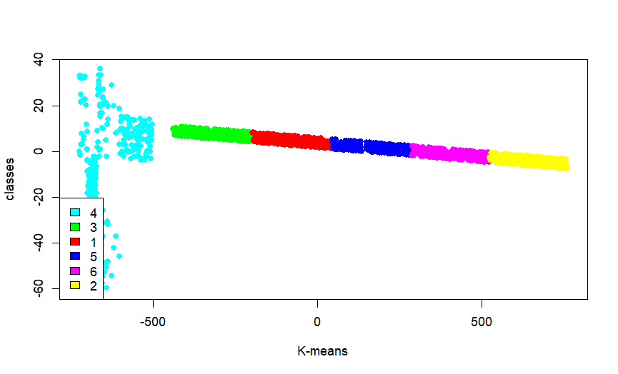
VISUALIZING THE CLUSTERING RESULTS USING THE FIRST TWO PRINCIPLE COMPONENTS

Slide 37
VISUALIZING THE CLUSTERING RESULTS USING THE FIRST TWO PRINCIPLE COMPONENTS
Cluster 4 and 1 – These two clusters consist of customers with medium PCA1 and medium PCA2 score.
Cluster 6 – This cluster represents customers having a high PCA2 and a low PCA1.
Cluster 5 – In this cluster, there are customers with a medium PCA1 and a low PCA2 score.
Cluster 3 – This cluster comprises of customers with a high PCA1 income and a high PCA2.
Cluster 2 – This comprises of customers with a high PCA2 and a medium annual spend of income.
With the help of clustering, we can understand the variables much better, prompting us to take careful decisions. With the identification of customers, companies can release products and services that target customers based on several parameters like income, age, spending patterns, etc. Furthermore, more complex patterns like product reviews are taken into consideration for better segmentation.

Slide 38
Conclusion
• K-Means Clustering is a powerful technique in order to achieve a decent customer segmentation.
• Customer segmentation is a good way to understand the behaviour of different customers and plan a good marketing strategy accordingly.
• There isn't much difference between the spending score of women and men, which leads us to think that our behaviour when it comes to shopping is pretty similar.
• Observing the clustering graphic, it can be clearly observed that the ones who spend more money in malls are young people. That is to say they are the main target when it comes to marketing, so doing deeper studies about what they are interested in may lead to higher profits.
• Although younglings seem to be the ones spending the most, we can't forget there are more people we have to consider, like people who belong to "middle class" and it seems to be the biggest cluster.
• Promoting discounts on some shops can be something of interest to those who don't actually spend a lot and they may end up spending more!

Slide 39
SUMMARY
In this data science project, we went through the customer segmentation model. We developed this using a class of machine learning known as unsupervised learning. Specifically, we made use of a clustering algorithm called K-means clustering. We analyzed and visualized the data and then proceeded to implement our algorithm.

